Slide 1



Order Processing System
By Caffeinated Coders
Sahib Singh- 45341121
Purvi Mishra- 45342439
Deepak Bisht- 45341218
Yashika Moon- 45341311
Ishika Pradhan- 45341312
Rachita Gupta- 45341272
Anshuman Chauhan- 45341067

Slide 2

AGENDA

Slide 3

Introduction
Order Processing System –
The Project is Web based Application for processing orders and generating
an invoice.
The project manages information of already Logged Customers and Employees.
It helps them to navigate and performs operations on Employee, Customers, Order Quote , Invoice Generation System .
Technologies used for backed-
JAVA
Technology Used by UI Team-
CSS
JavaScript
HTML

Slide 4
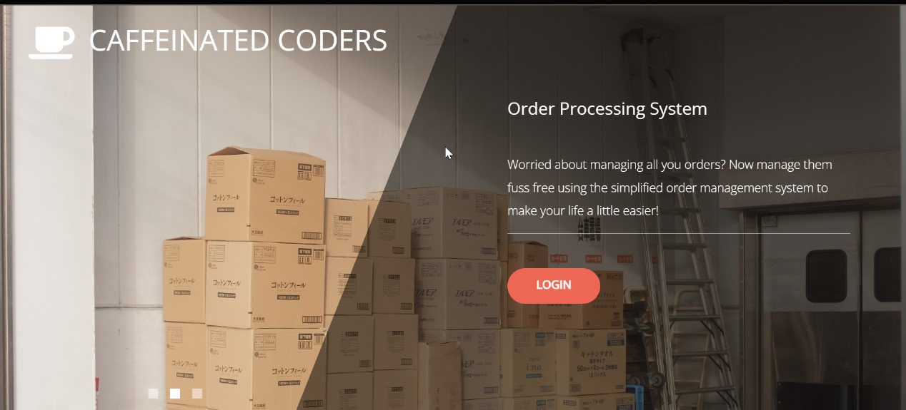
Caffeinated Coders Presents Order Processing
System!!!

Slide 5
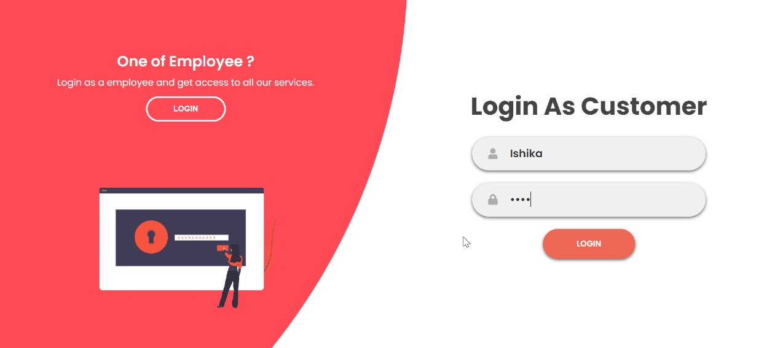
'Customer is king.' Embrace the power to explore, shop & engage, as your unique journey begins with each login.

Slide 6


Customer Login
Customer id and password should match.
Business Rule:
All the fields are required
If the current date is more than 30 days of the order date, the approval fails and the status is set to expired.
If the current date is less than or equal 30 days of the order date, the order is approved

Slide 7
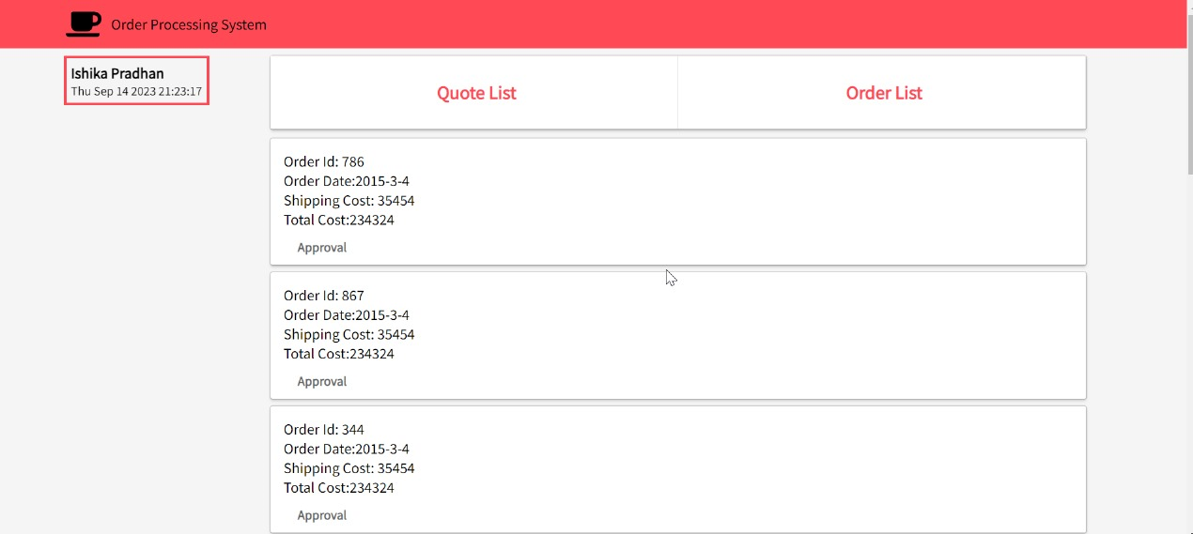
Quotes are the backbone of our Order Processing System, capturing the essence of customer needs and desires. With each order, we transform these quotes into a reality, delivering products and services that fulfill promises made.

Slide 8
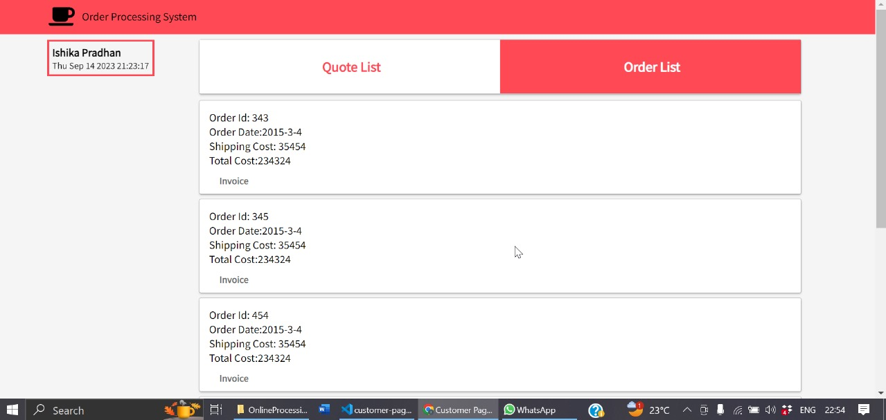
Your Order List is the heartbeat of our Order Processing System. It's where your preferences and choices become tangible realities, meticulously organized and ready for efficient processing

Slide 9
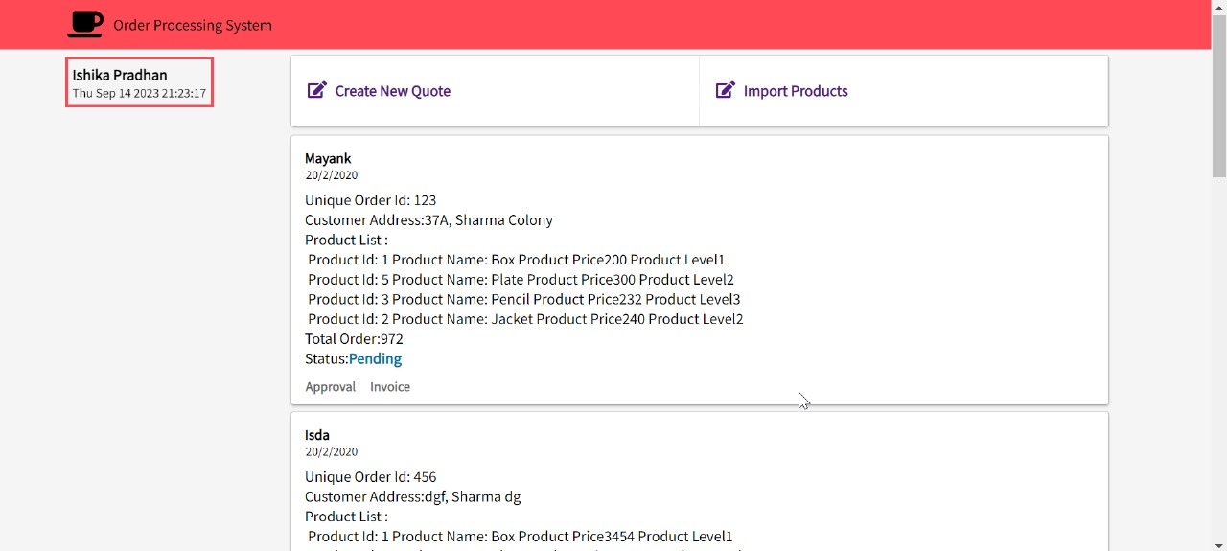
Employee Management Page shows the Status of order. Either it’s pending or
it’s Approved.
Note – We can’t create Invoice if the status is Pending

Slide 10
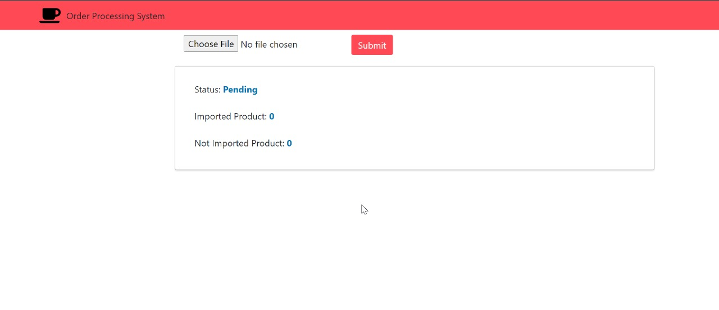
Importing Order

Slide 11
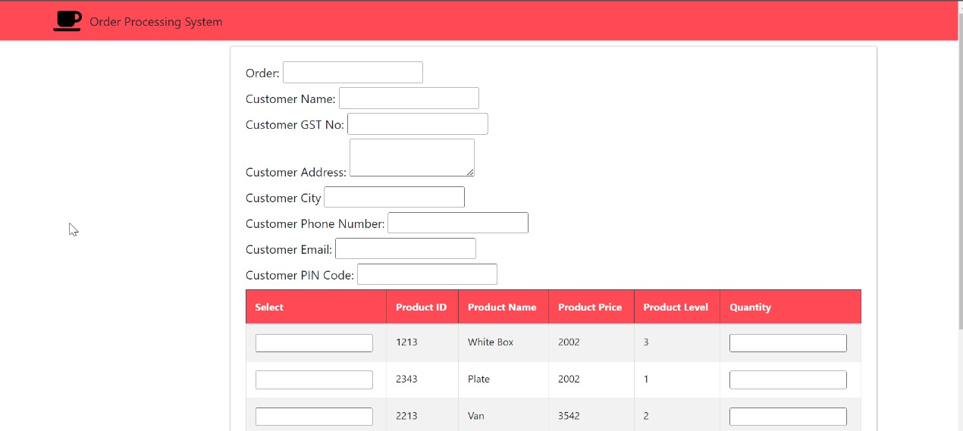
Creating Quote

Slide 12
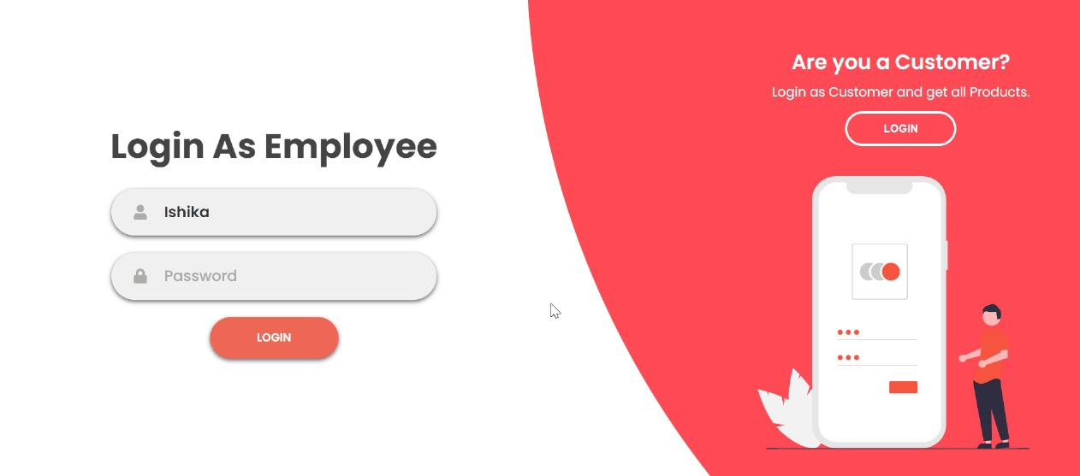
"Employee login is the gateway to productivity and collaboration. With secure access to our system, our valued team members unlock the potential to work together, contribute their skills, and drive success forward."

Slide 13

Employee Login
Employee id and password should match.
Employee should not be already logged in.
Business Rule:
1. All product fields are mandatory
2. If there are duplicate id in the file, those records should be ignored.
3. If there is a product with the same id in the database, it should be updated with the new details.

Slide 14
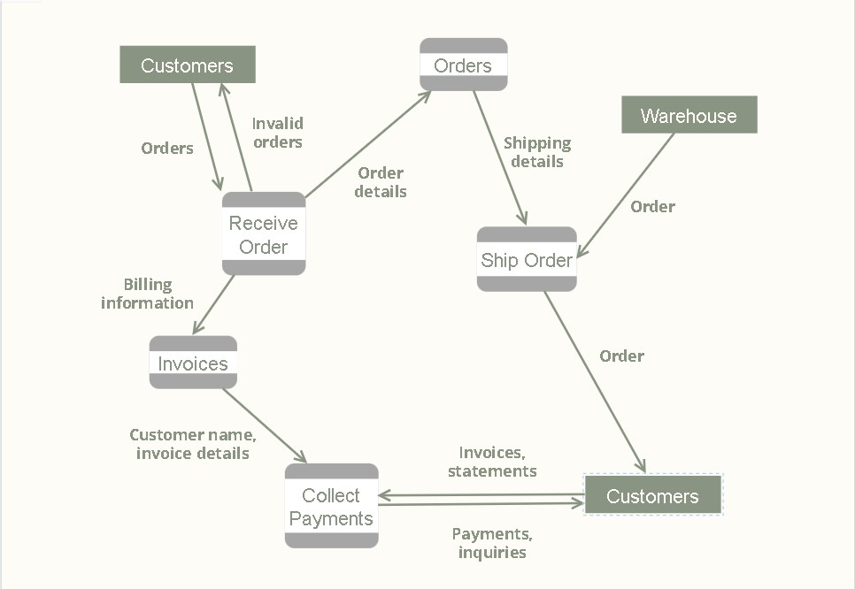
DATA FLOW DIAGRAM

Slide 15

Project Modules
System store all the data in databases.
1. Customer(Buyer)
4. Invoice
2. Product
5. Company(Seller)
6.Employee
3. Order

Slide 16

Business Logic
Employed layered architecture with loose coupling.
.

Slide 17

Application Design
Used an RDBMS server to store all business data. Data is normalized. The database design (tables and columns) based on the application and business requirement.
Application is oriented and easily extensible to add new features and other use cases
The web application is based on MVC design pattern
The UI layer should follows a responsive design.
Business rules shared implemented in a separate layer.
Implement a proper data-access layer.
Used proper exception handling.
Provided a logout option
Pages are designed as responsive

